Slide 1
Wetlands, Transition Areas and Regulations
Robert (Bo) Petrillo, MNR, PWS, CE

Slide 2
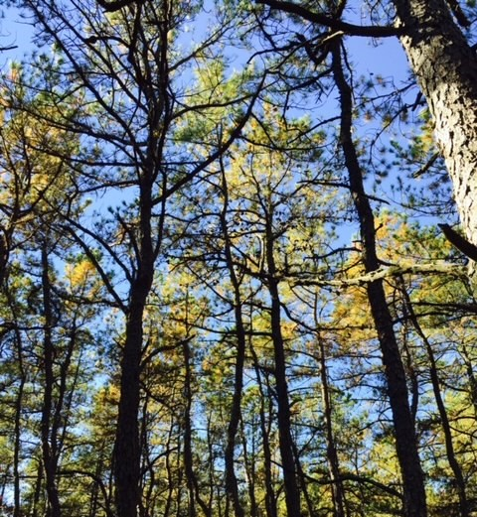
Ecologist/ Environmental Project Manager
Bachelors Degree in Biology (Arcadia University)
Masters Degree in Restoration Ecology (University of Idaho)
Professional Wetland Scientist (Society of Wetland Scientists)
Certified Ecologist (Ecological Society of America)

Slide 3
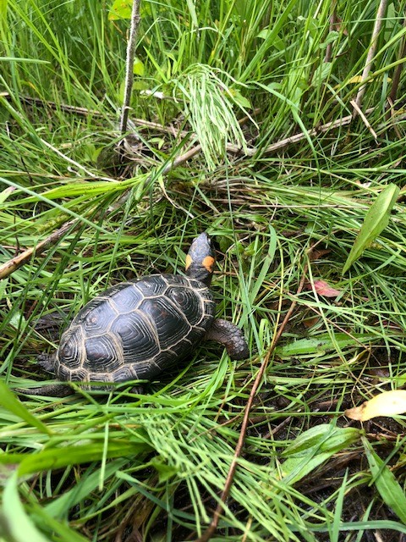
Importance of Wetlands
Flood Protection (distribute force of storm surges & serve as water storage areas)
Biodiversity (up to 40% of all species live in wetlands)
Climate Change (store more carbon than mature forests)
Water filtration (trap and slowly release water capturing sediment and pollutants)

Slide 4
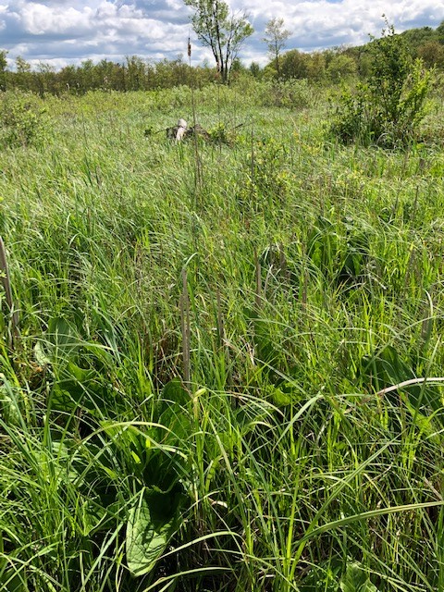
Identifying Wetlands
Utilizing online databases such as NJDEP Geoweb, USFWS Wetlands Mapper and USGS Web Soil Survey
Utilizing the three (3) parameter approach for field delineations

Slide 5
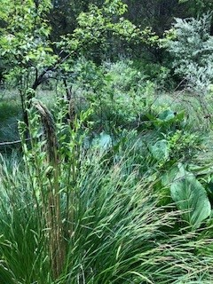
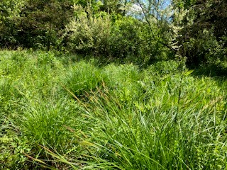
Hydrophytic Vegetation
Plants that grow in wetlands
Vegetation is categorized according to percentage of time it is found in a wetland (OBL, FACW, FAC, FACU, UPL)
Common Species include skunk cabbage, soft rush, highbush blueberry, Atlantic white cedar.
You can utilize applications on your smartphone to determine species!

Slide 6
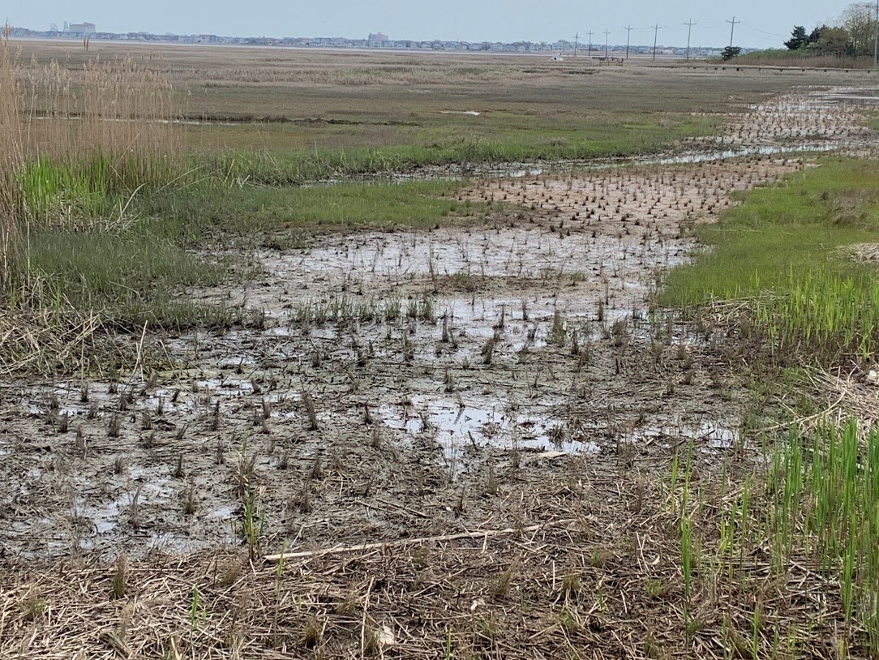
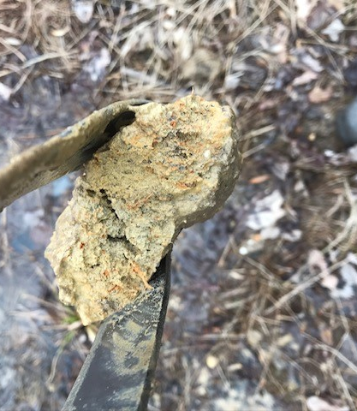
Hydric Soils
Soils change based on the presence of a high-water table.
In mineral soils this creates a depleted matrix (gleyed coloration)
In sandy soils you see high organic content, streaking and a bleached A horizon.
The anaerobic environment due to the high-water results in oxidized rhizospheres and redoximorphic concentrations along root channels.

Slide 7
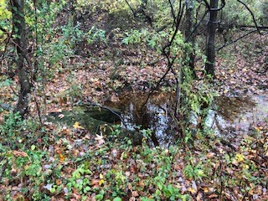
Hydrology
Water table within 12 inches from surface for a minimum of 2 weeks during the growing season.
Common signs of hydrology are geomorphic position, water-stained leaves, buttressed roots, standing water, hydrophytic vegetation.

Slide 8
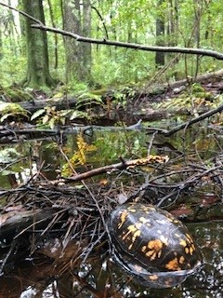
Regulations in NJ
New Jersey Department Environmental Protection (NJDEP)
United States Army Corps of Engineers (USACE)
New Jersey Pinelands Commission
New Jersey Sports and Exposition Authority (NJSEA)

Slide 9
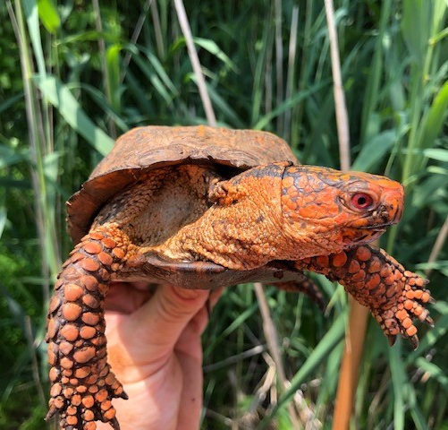
NJDEP & Pinelands
NJDEP regulates wetlands under the Freshwater Wetlands Protection Act
Pinelands Regulates Wetlands under the Pinelands Comprehensive Management Plan (CMP)
Both utilize the LOI to verify wetlands.
General Permits and Individual Permits

Slide 10
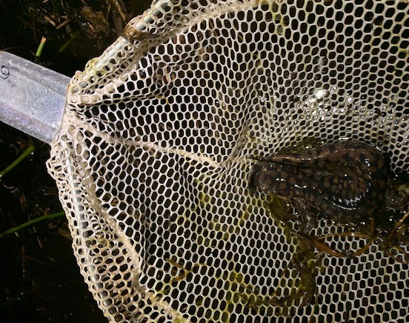
Transition Areas (Wetland Buffers)
The upland area located adjacent to the wetland
Determined by the NJDEP and Pinelands.
In NJDEP regulated areas TA is determined based on wetland functional value (0’, 50’ 150’)
Pinelands regulates a 300’ Buffer
Verified by the lead agency and activities within the TA are regulated just like wetland impacts!

Slide 11
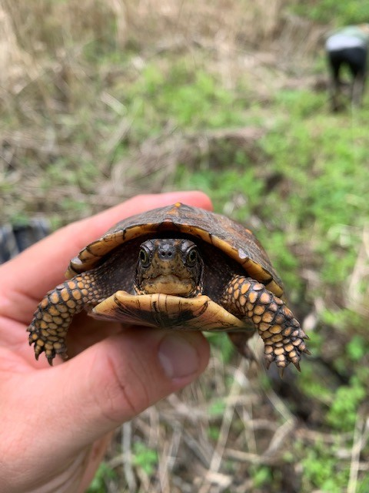
Questions?

