Slide 1
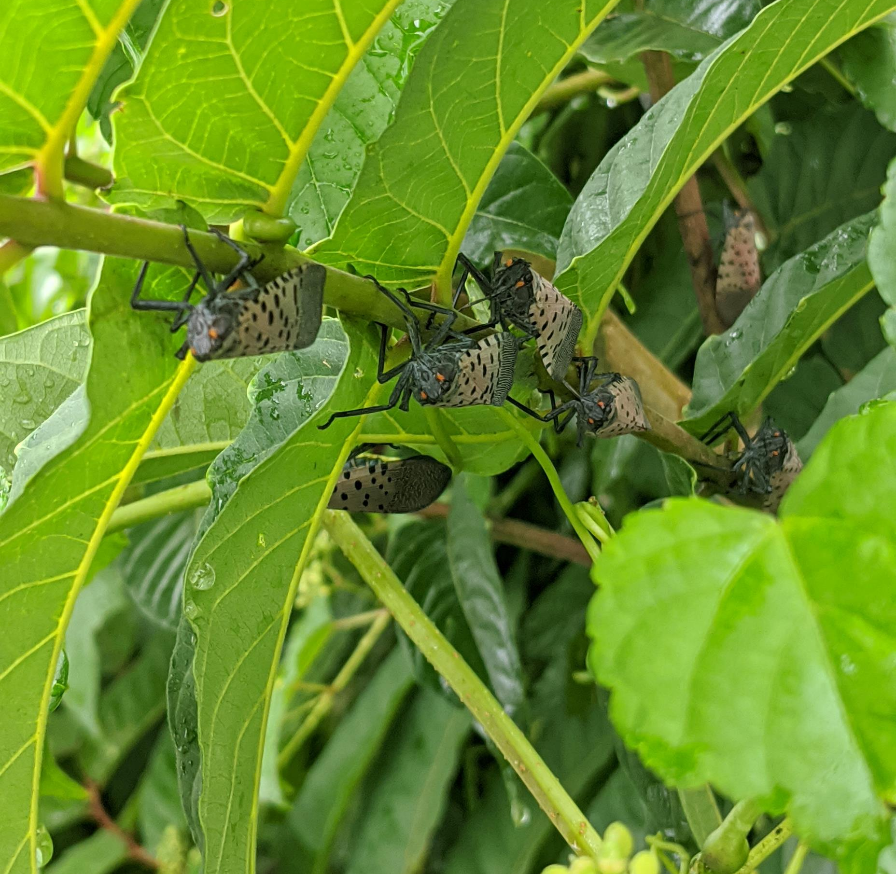
Spotted Lanternfly
Saul Vaiciunas
New Jersey Department of Agriculture

Slide 2
Native distribution

Slide 3
Potential range in the USA

Slide 4
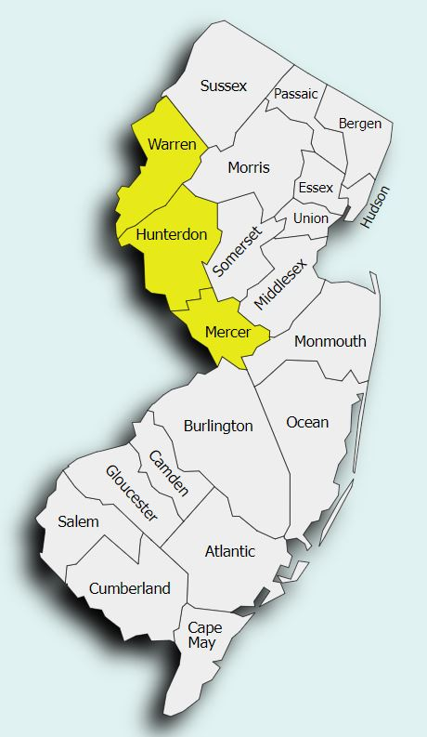
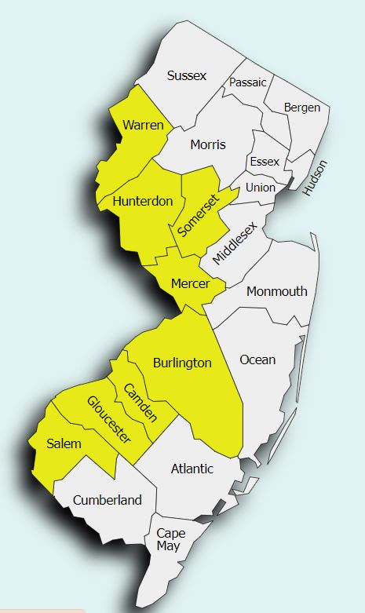
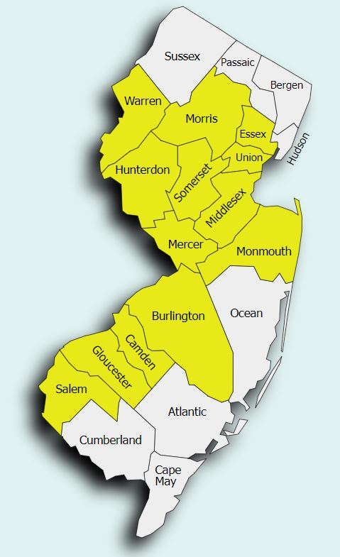
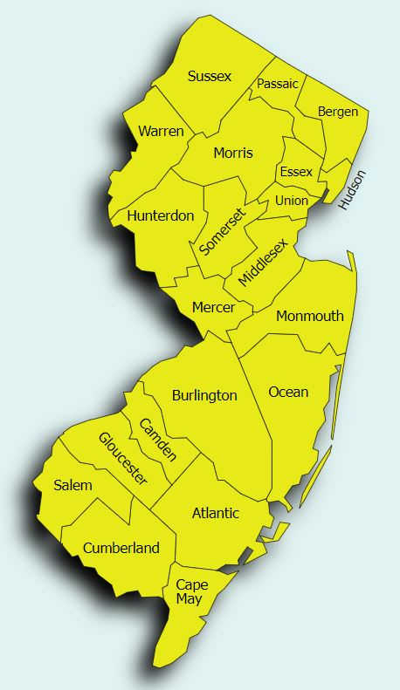
NJ SLF quarantines
2018
2019
2021
2023

Slide 6
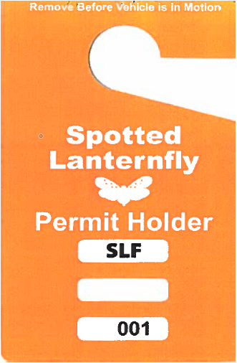
Don’t move spotted lanternfly
Go to www.badbug.nj.gov
Plain language quarantine
When travelling inspect for all life stages
Get a permit, it’s easy and free!
All pesticide and control recommendations are there

Slide 7
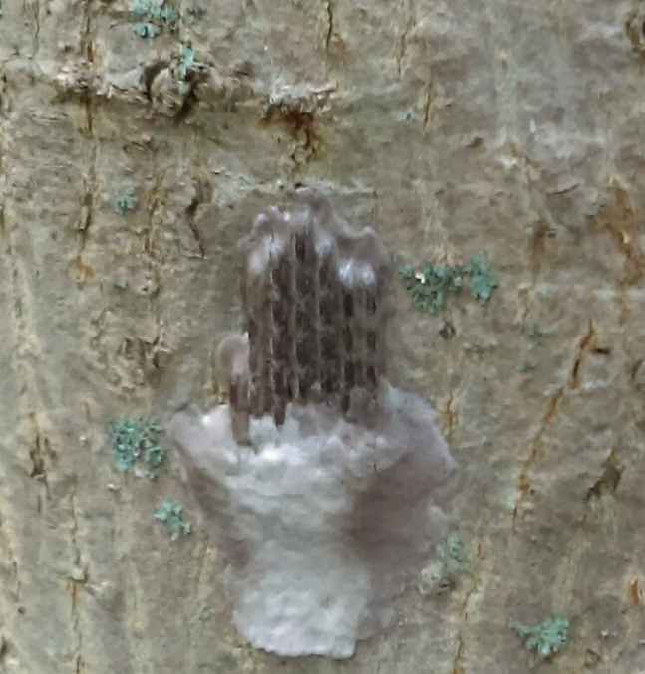
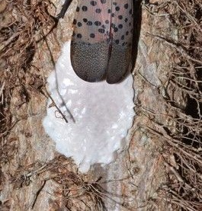
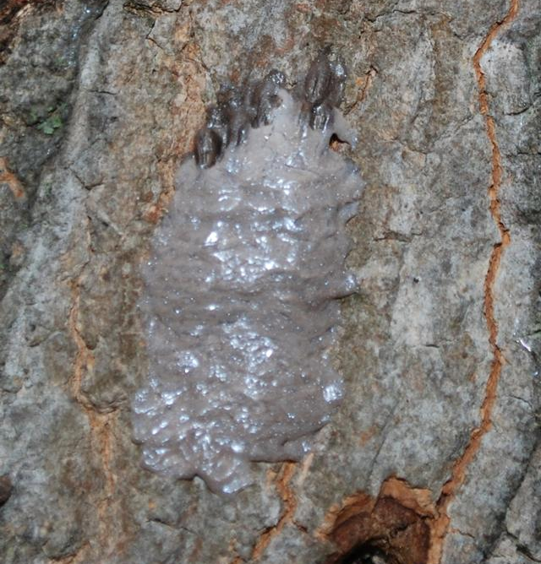
SLF egg masses

Slide 9
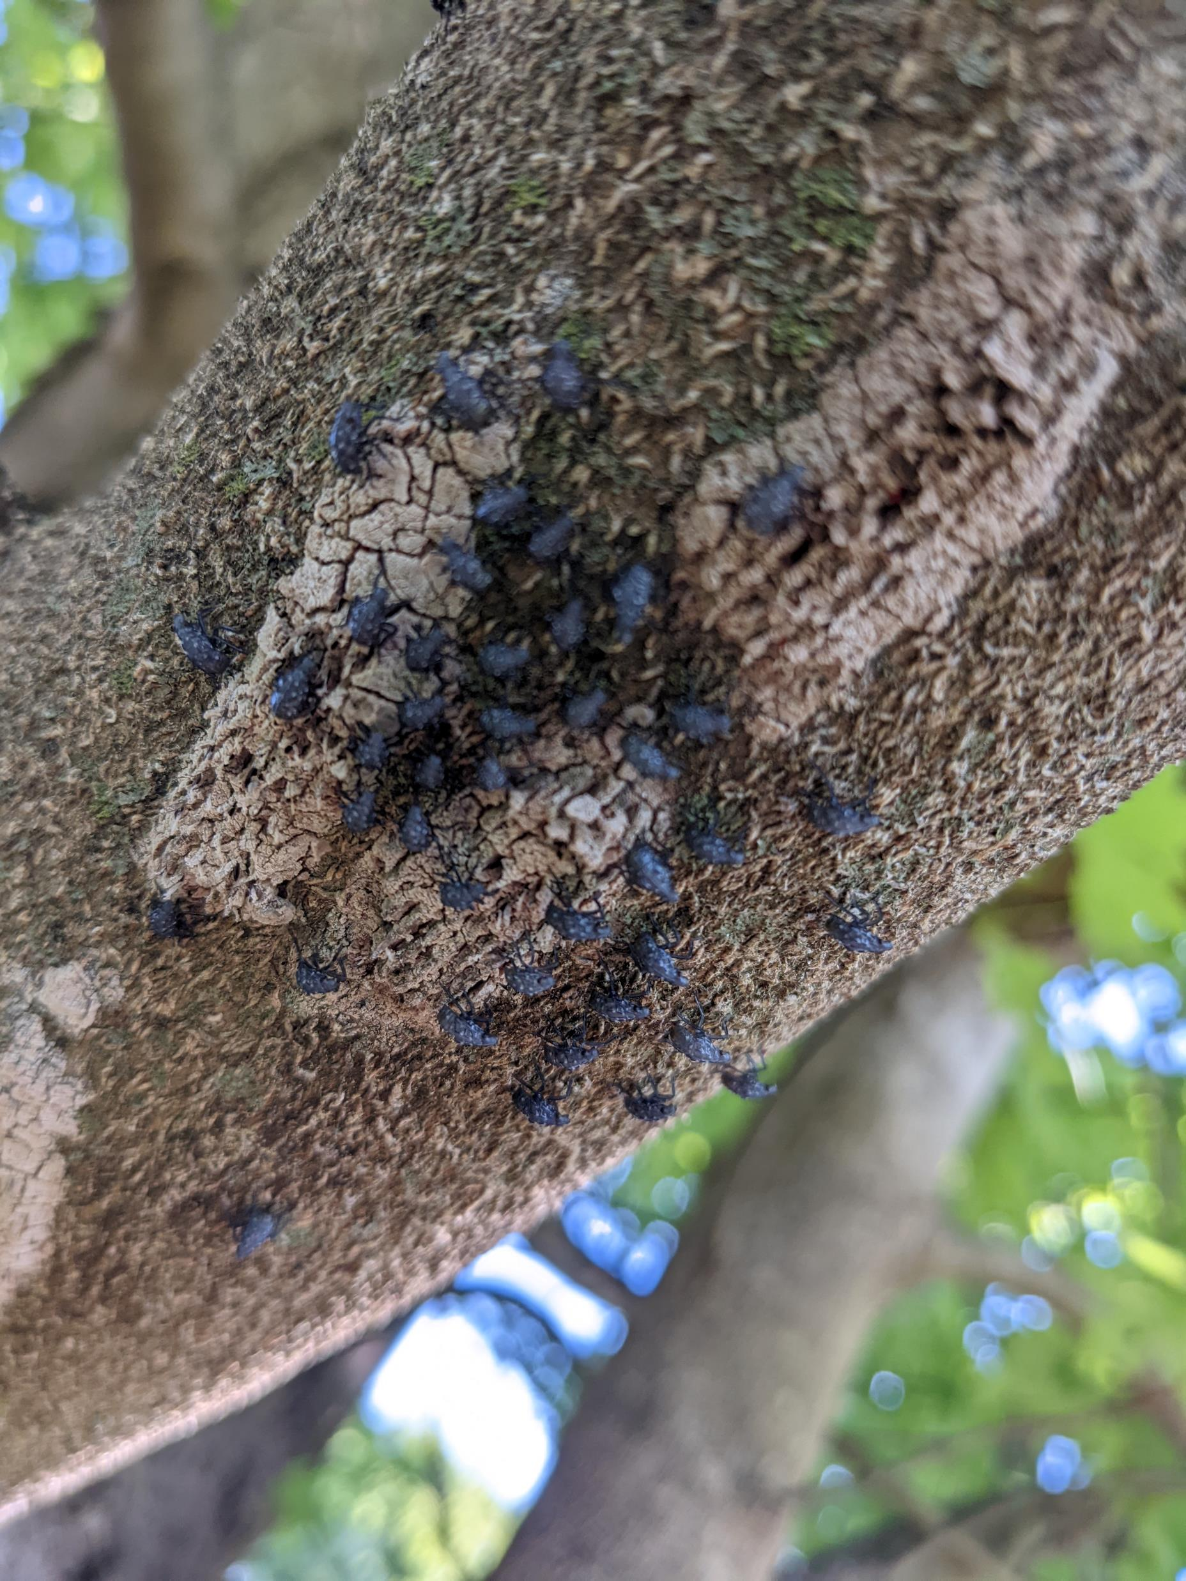
Eggs hatching out

Slide 10
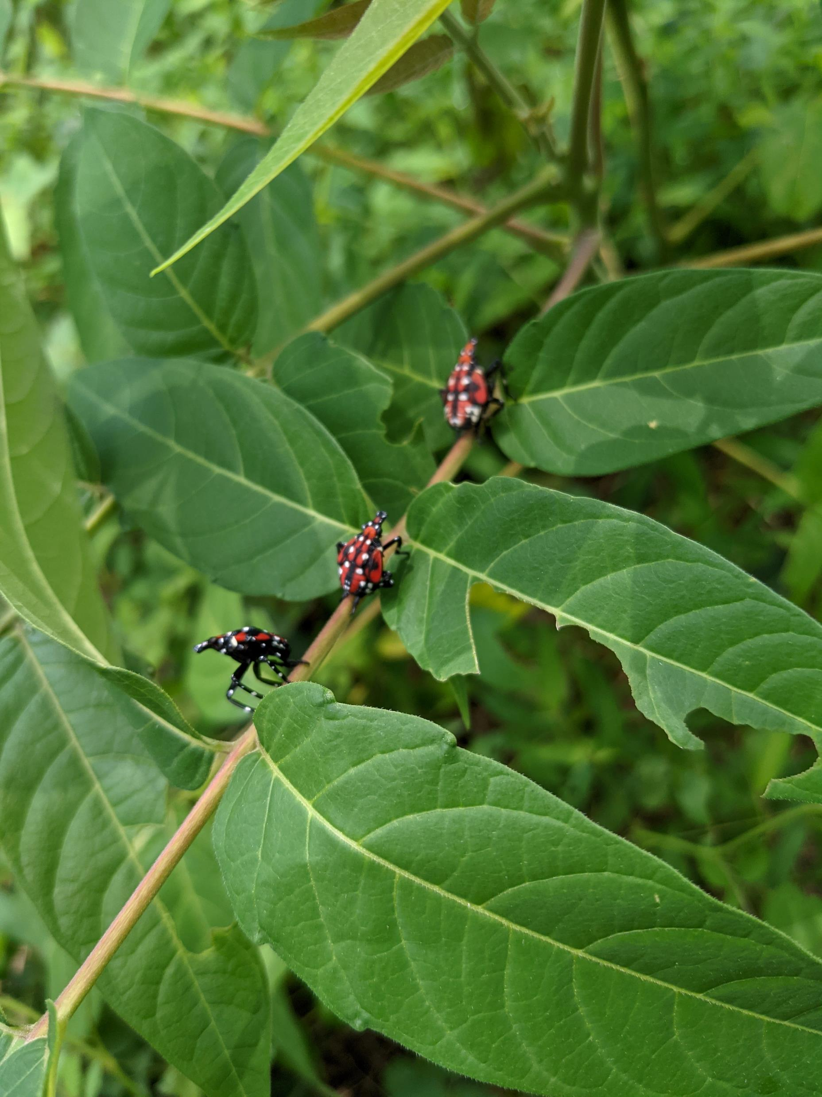
Nymphs and Adults

Slide 11
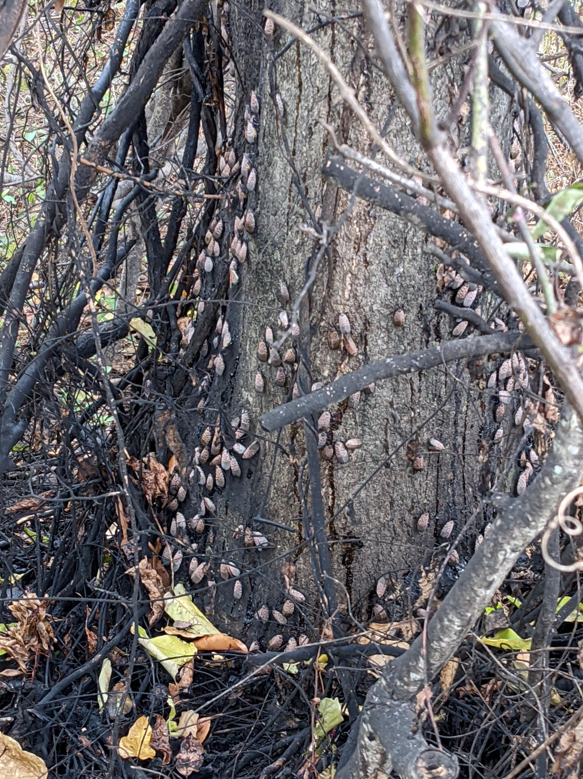
Damage

Slide 12
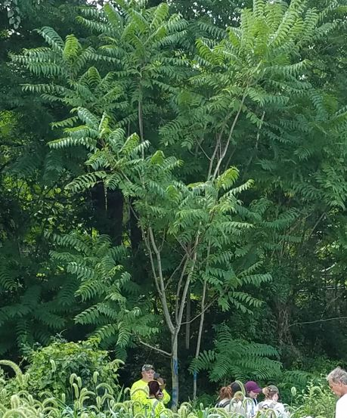
Tree of Heaven (Ailanthus altissima)
Compound leaves
Rancid peanut butter smell
Disturbed areas
Invasive tree
Fast growth, weak wood
Fruit is samara
Look a likes are walnut and sumac

Slide 13
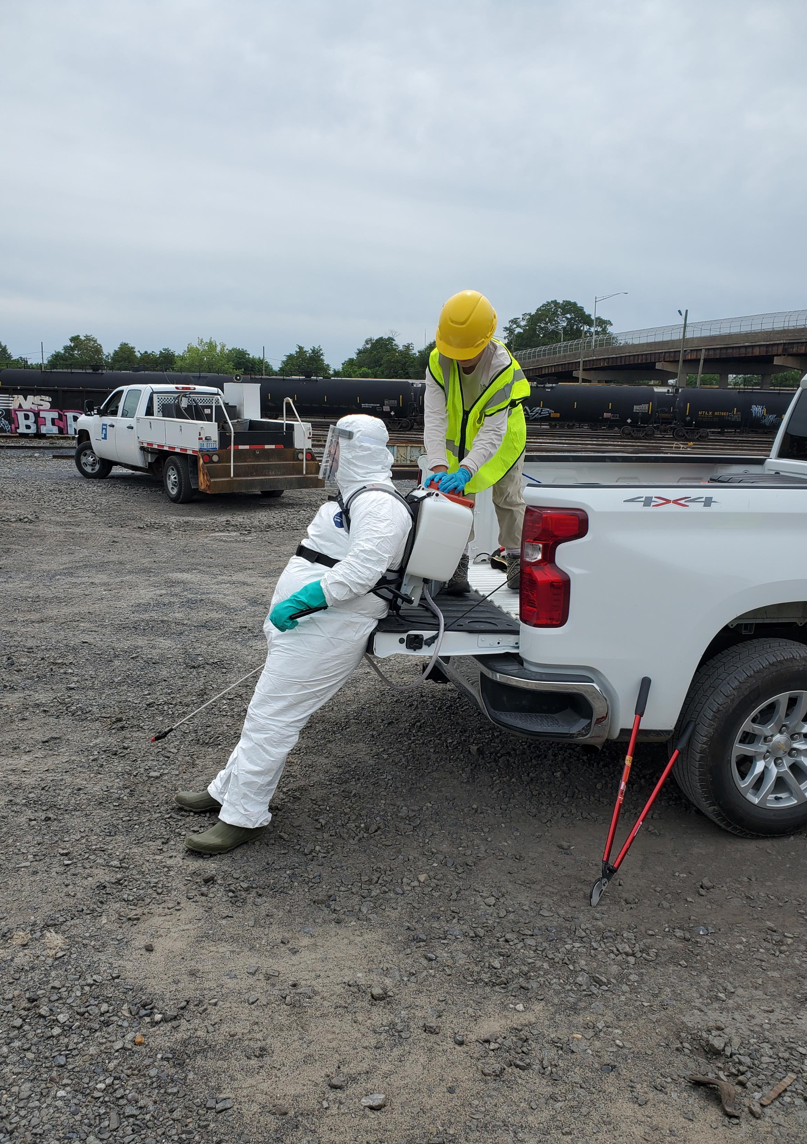
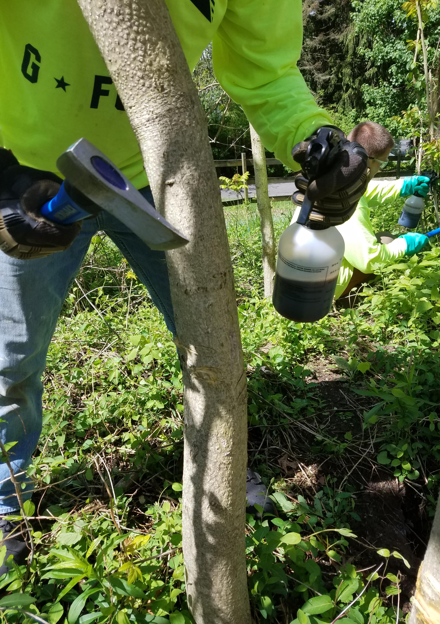
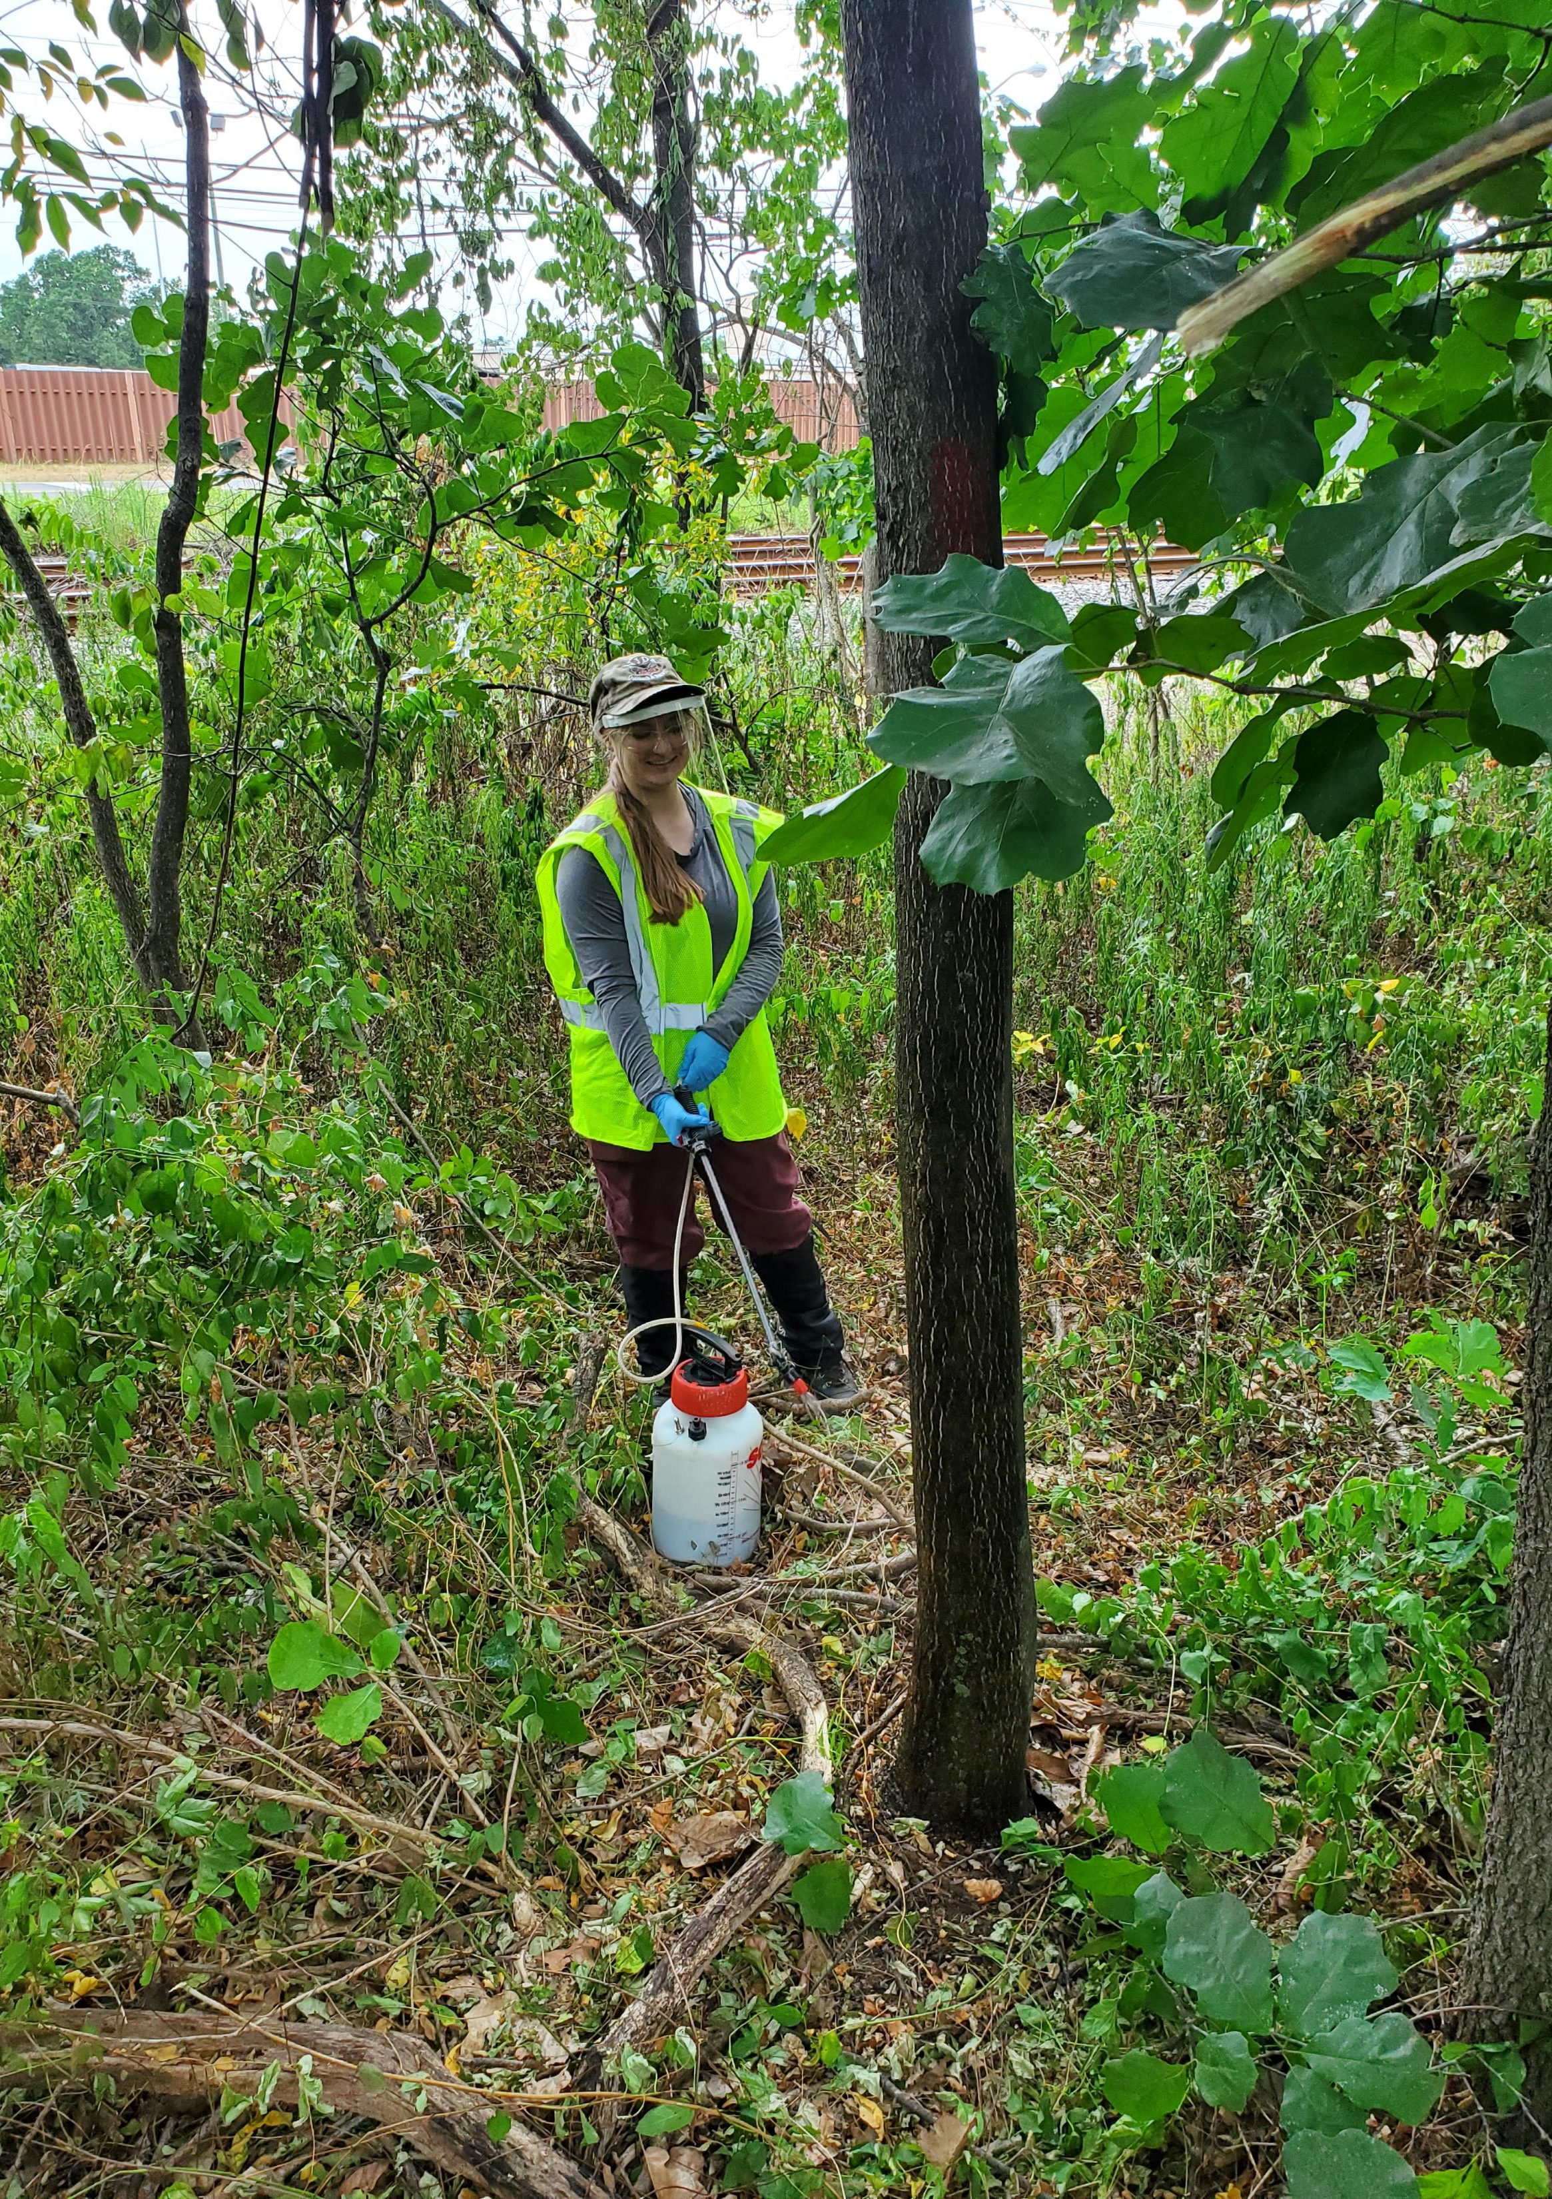
Pesticide Treatments

Slide 14
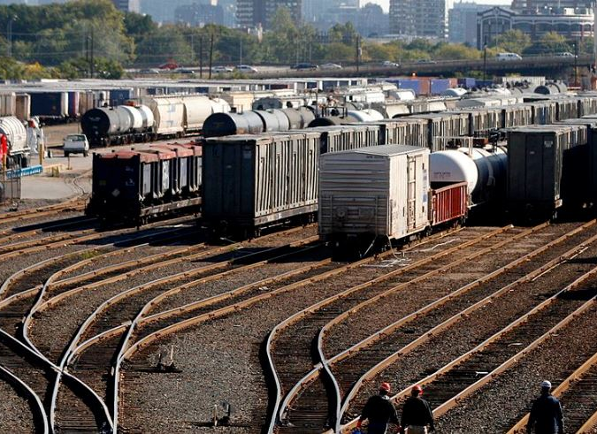
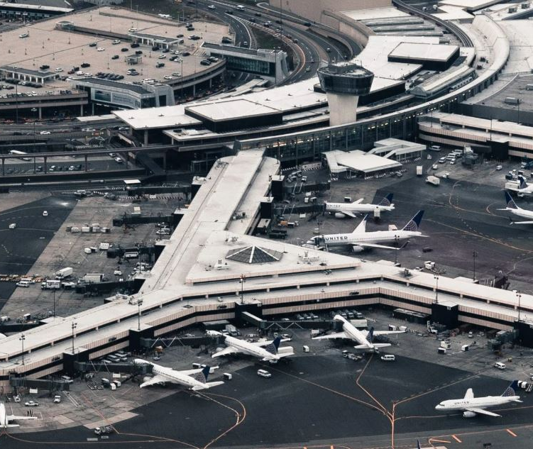
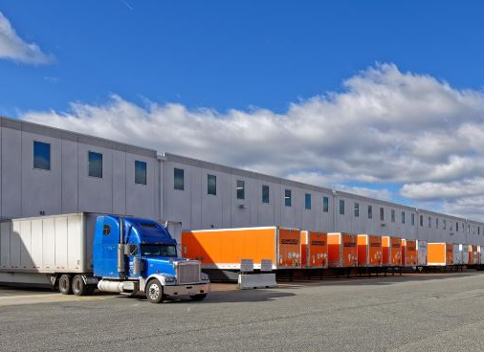
Priority locations to slow the spread

Slide 15
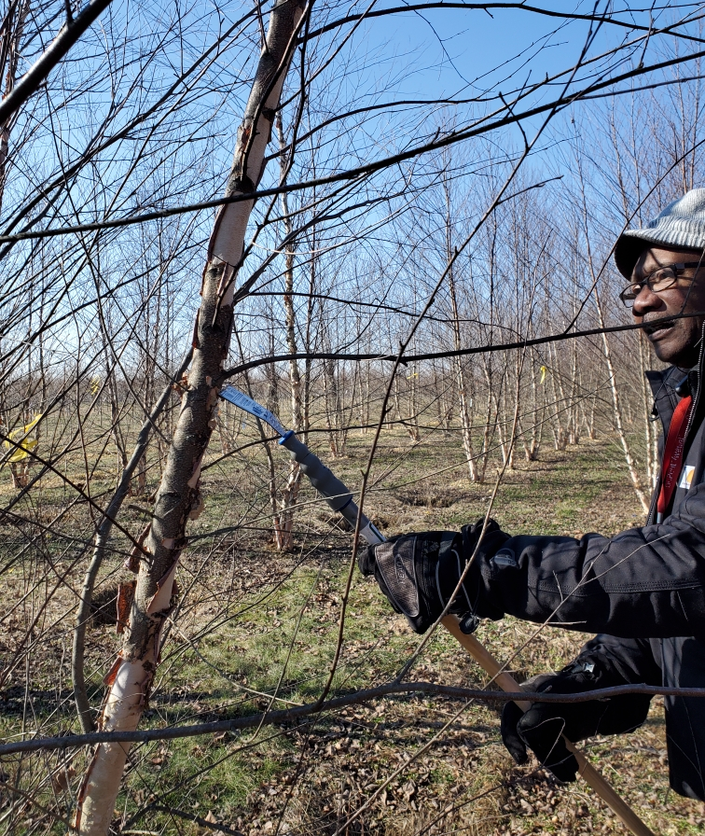
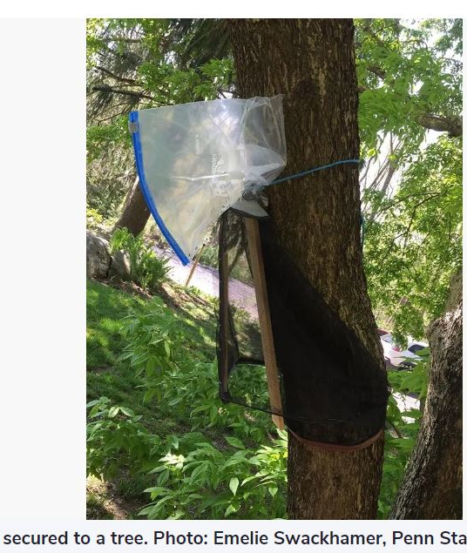
Non-pesticide control
Scrape and crush egg masses – over 300,000 in one winter
Trap nymphs or adults – over 100,000 in one seasone

Slide 16
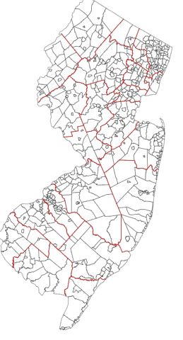
State program
Reimbursement to county government up to $15,000
Possible increase planned
Possibly will include municipal government soon
Ask me after July 1

Slide 17
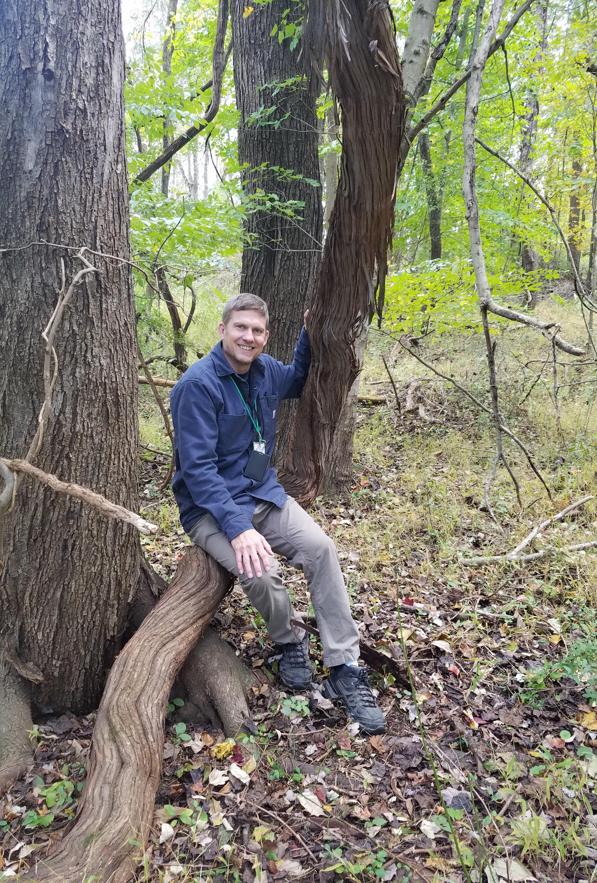
Questions? saul.vaiciunas@ag.nj.gov

